Slide 1
Impact of Urbanization on Flooding Maxwell Moshier May 4, 2026
CIE 500
AI & Complex Networks Infrastructure Systems
Spring 2026

Slide 2
Motivation
Increasing Urbanization can lead to an increased risk of flooding.
This is due to there being less infiltration and higher surface runoff in these urbanized areas.
Target: Develop a model which can predict flood risk in urbanized areas.
A supervised model will be used because we are trying to predict (classify) flood risk.

Slide 3
Methodology
Step 1: Identify study area for the model.
Step 2: Identify the necessary datasets for the model.
Step 3: Implement all data into one file.
Step 4: Split the data into train/validate/split.
Step 5: Utilize Random forest to train the model.
Step 6: Run a final evaluation of the model.

Slide 4
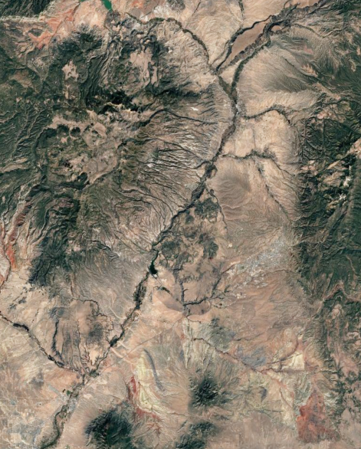
Study Area
Rio Grande River:
Ohkay Owingeh
Espanola
Corrales
Rio Rancho
Albuquerque
Figure 1: Image of Rio Grande River (Source: Google Earth 2021).

Slide 5
Datasets
Datasets | Purpose | Source
Population | Used to create samples based on areas with varying populations. | New Mexico Resource Graphic Information System
Land Use | Used to break up samples based on what the land is being used for. | New Mexico Resource Graphic Information System
Flow Rate | Used to show flow rate in Rio Grande River based on major storm events. | USGS National Water Dashboard
Precipitation | Used to show the amount of rainfall in relevant locations. | National Oceanic and Atmospheric Administration
Flood Risk | This is the target. It is used to show the locations in the study area that are prone to flooding. | FEMA’s National Flood Hazard Layer

Slide 6
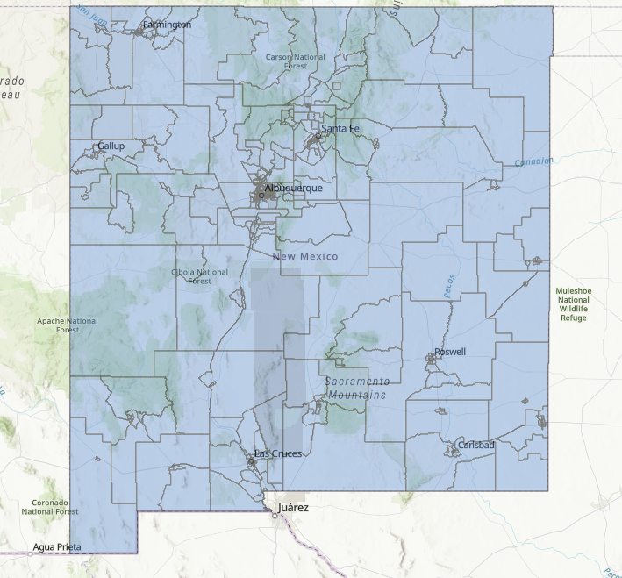
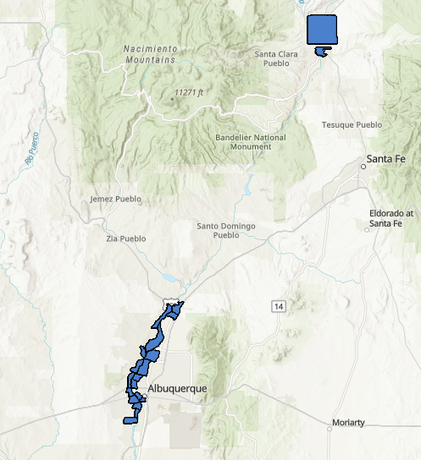
Population Data
Figure 2: Population data per tract (Source: ArcGIS, 2026).
Figure 3: Simplified population data per tract (Source: ArcGIS, 2026).

Slide 7
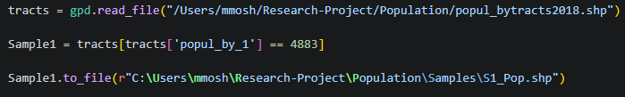
Population Data
Figure 4: Example of code used to make samples (Source: VSCode, 2026).
Sample 1: 4883
Sample 2: 6839
Sample 3: 6809
Sample 4: 4303
Sample 5: 3573
Sample 6: 3510
Sample 7: 6541
Sample 8: 5195
Sample 9: 4814
Sample 10: 2699
Sample 11: 1968
Sample 12: 3789
Sample 13: 4391
Sample 14: 5270
Sample 15: 3068
Sample 16: 9017
Sample 17: 2790
Sample 18: 5604
Sample 19: 3322
Sample 20: 4130

Slide 8
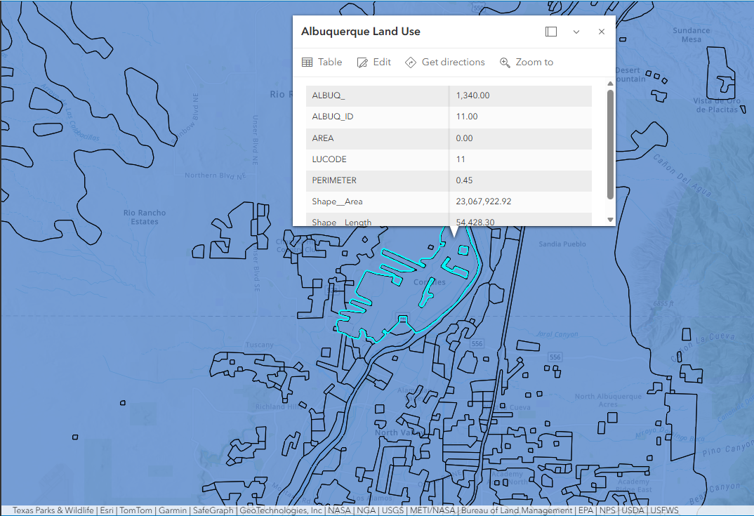
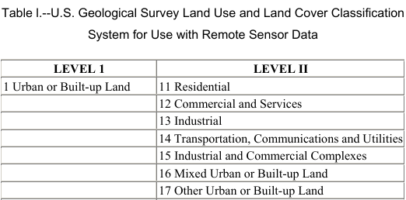
Land Use Data
Figure 6: Portion of table explaining land use code. (Source: USGS).
Figure 5: Land use data example. Example from Corrales. (Source: ArcGIS, 2026).

Slide 9
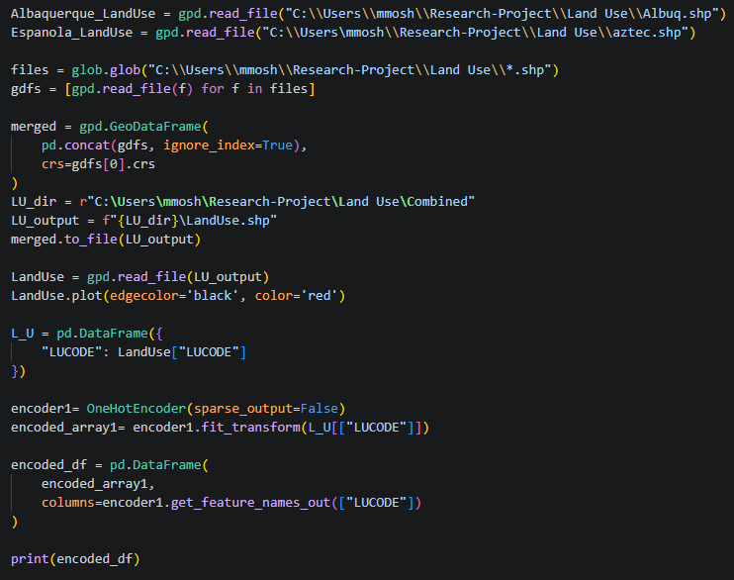
Land Use Data
Figure 7: Code used to introduce land use data. (Source: VSCode, 2026).

Slide 10
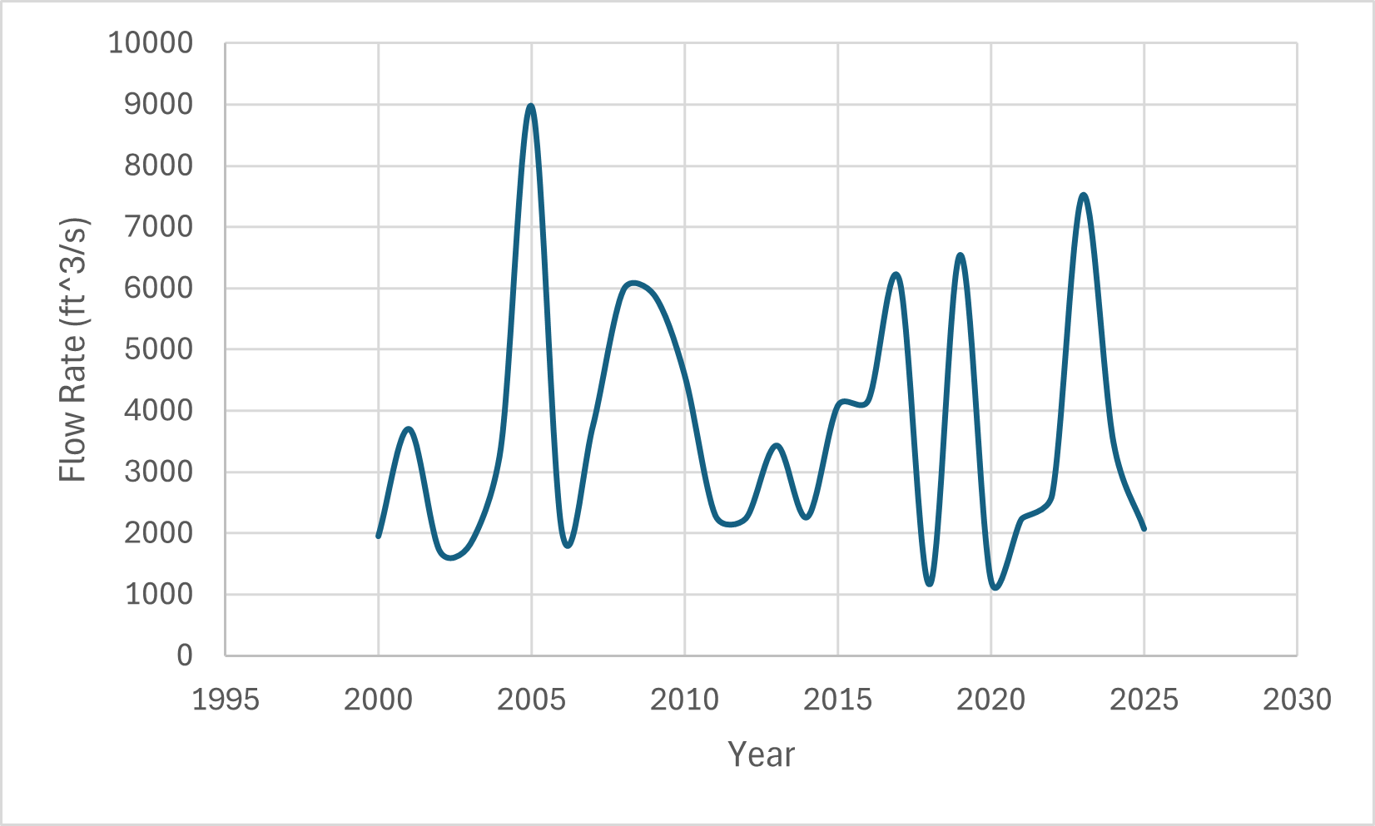
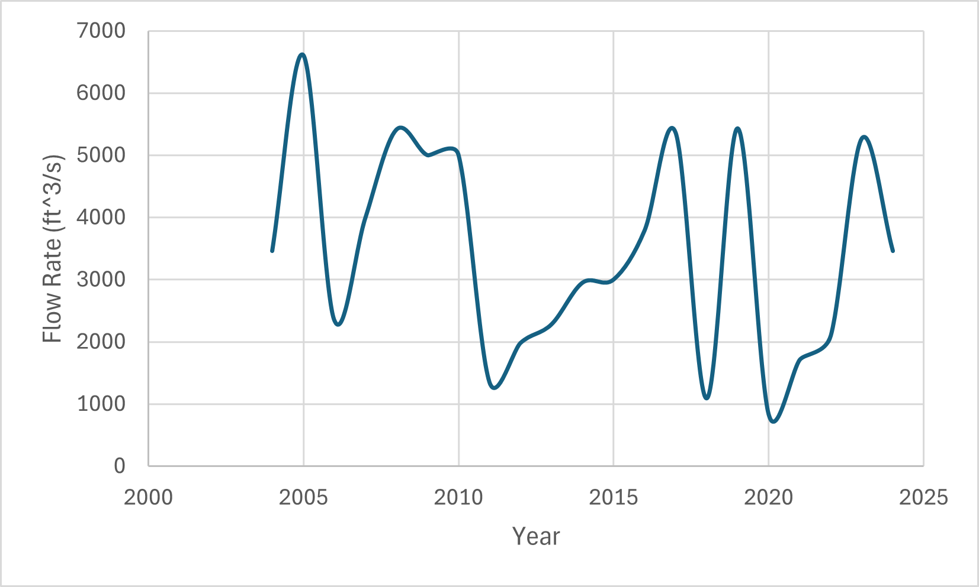
River Discharge
Ohkay Owingeh and Espanola:
Corrales, Rio Rancho and Albuquerque:
Figure 8: Graph of maximum flow rates in Ohkay Owingeh and Espanola region. (Source: Excel, 2026).
Figure 9: Graph of maximum flow rates in Albuquerque region. (Source: Excel, 2026).
Max Flow Rate = 8970 cfs
Max Flow Rate = 6610 cfs

Slide 11
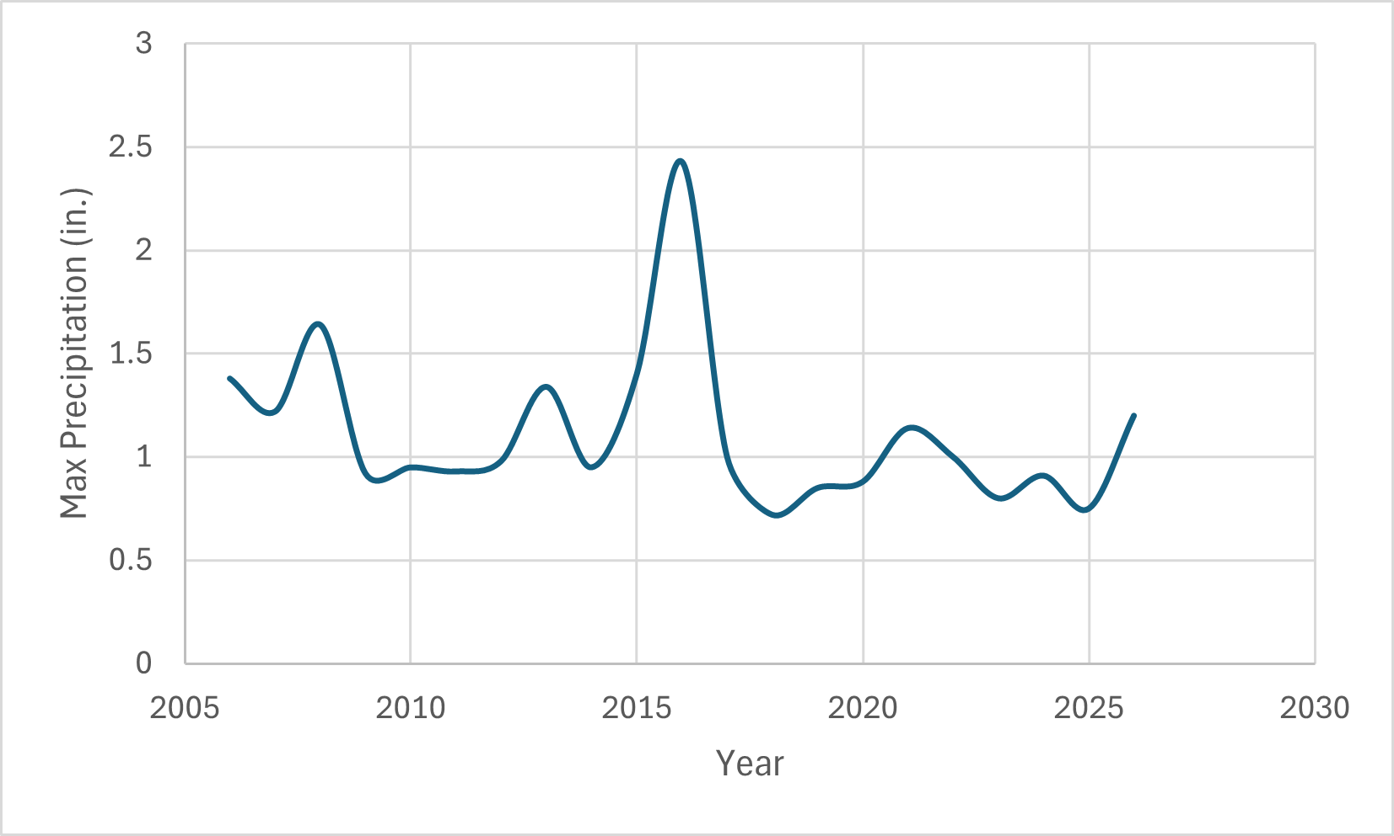
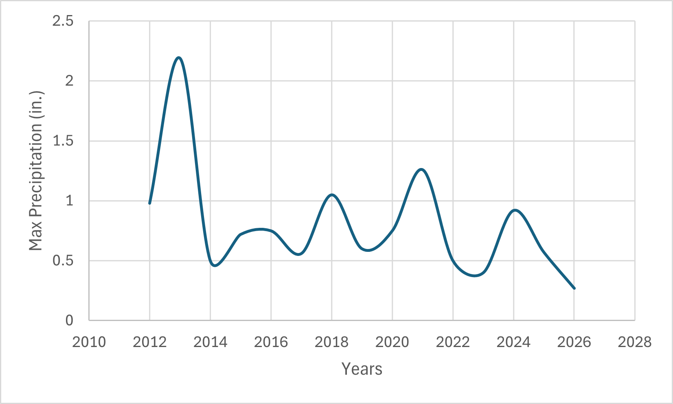
Precipitation Data
Ohkay Owingeh and Espanola:
Corrales, Rio Rancho, and Albuquerque:
Figure 10: Graph of maximum precipitation in Ohkay Owingeh and Espanola region. (Source: Excel, 2026).
Figure 11: Graph of maximum precipitation in Albuquerque region. (Source: Excel, 2026).
Max Precipitation = 2.43 in.
Max Precipitation = 2.19 in.

Slide 12
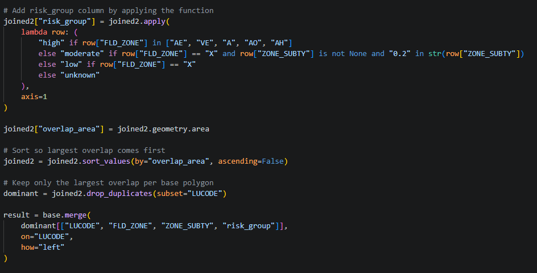
Flood Risk Data
Figure 12: Code used to implement flood risk data (Source: VSCode, 2026).

Slide 13
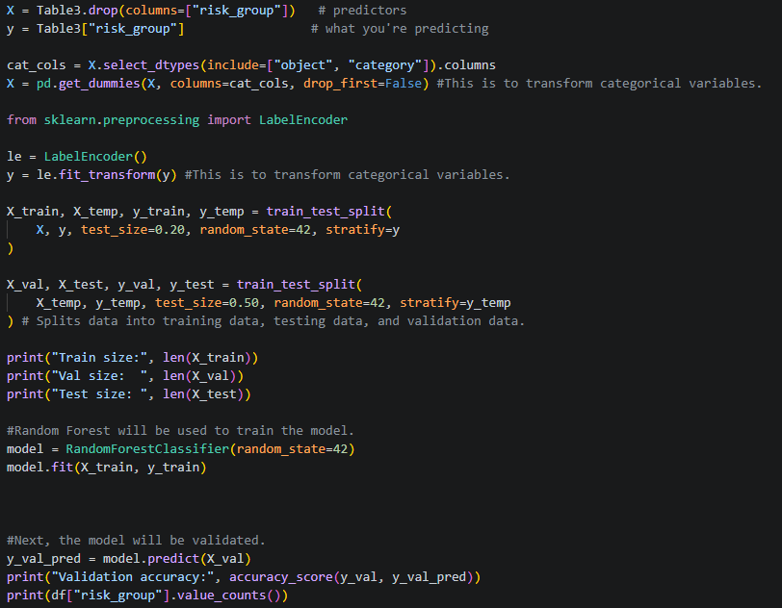
Training/Testing
60/40:
Testing Accuracy= 0.81
70/30:
Testing Accuracy= 0.79
80/20:
Testing Accuracy= 0.83
90/10:
Testing Accuracy= 0.76
Figure 13: Code used to train and test the data (Source: VSCode, 2026).

Slide 14
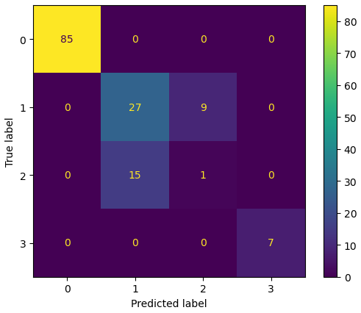
Evaluation
Figure 14: Confusion matrix for dataset (Source: VSCode, 2026).

Slide 15
Discussion
Based on testing accuracy the model performed well.
However, based on the confusion matrix there are difficulties when predicting two out of the four risk groups.
To improve the model more samples could be taken into consideration.
Also, other study areas could be considered to improve the model.

Slide 16
Thank you!
Questions?

Slide 17
Resources
‌United States Census Bureau. (2023). Explore Census Data. United States Census Bureau. https://data.census.gov/
‌ArcGIS Web Application. (n.d.). Hazards-Fema.maps.arcgis.com. https://hazards-fema.maps.arcgis.com/apps/webappviewer/index.html?id=8b0adb51996444d4879338b5529aa9cd
‌USGS | National Water Dashboard. (n.d.). Dashboard.waterdata.usgs.gov. https://dashboard.waterdata.usgs.gov/app/nwd/en/
Google Earth. (2025). Google Earth. Google.com; Google. https://earth.google.com/web
Browse rgis data. (n.d.). Rgis.unm.edu. https://rgis.unm.edu/rgis6/
‌Past Weather | National Centers for Environmental Information (NCEI). (n.d.). Www.ncei.noaa.gov. https://www.ncei.noaa.gov/access/past-weather/
‌Map Viewer. (2026). Arcgis.com. https://suny-buffalo.maps.arcgis.com/apps/mapviewer/index.html?webmap=ef14548f0aea4a70908d02229a9b149b

